Slide 1



Sales & Performance Analysis Power BI Dashboard
View in Power BI
Last data refresh:
12/10/2024 5:43:02 PM UTC
Downloaded at:
12/15/2024 10:02:07 PM UTC

Slide 2
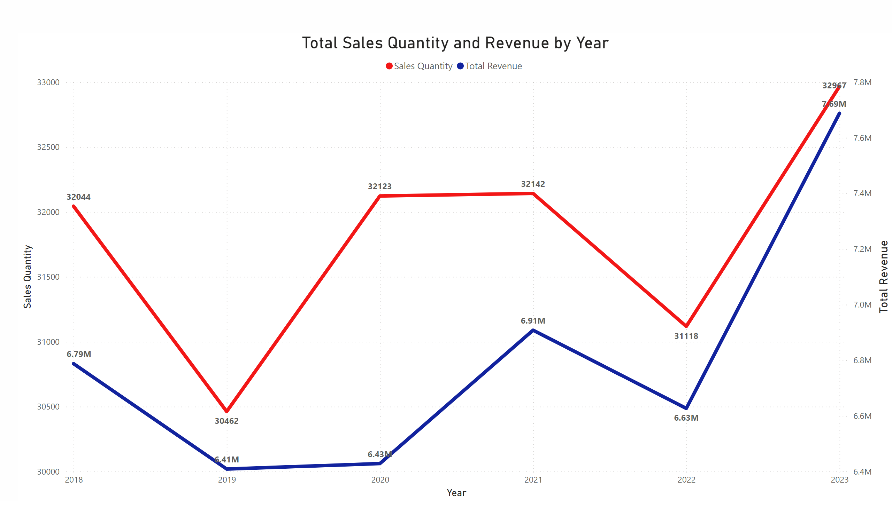
1a - Quantity and Revenue by Year
Notes:
Total Sales Quantity and Revenue by Year
No alt text provided

Slide 3
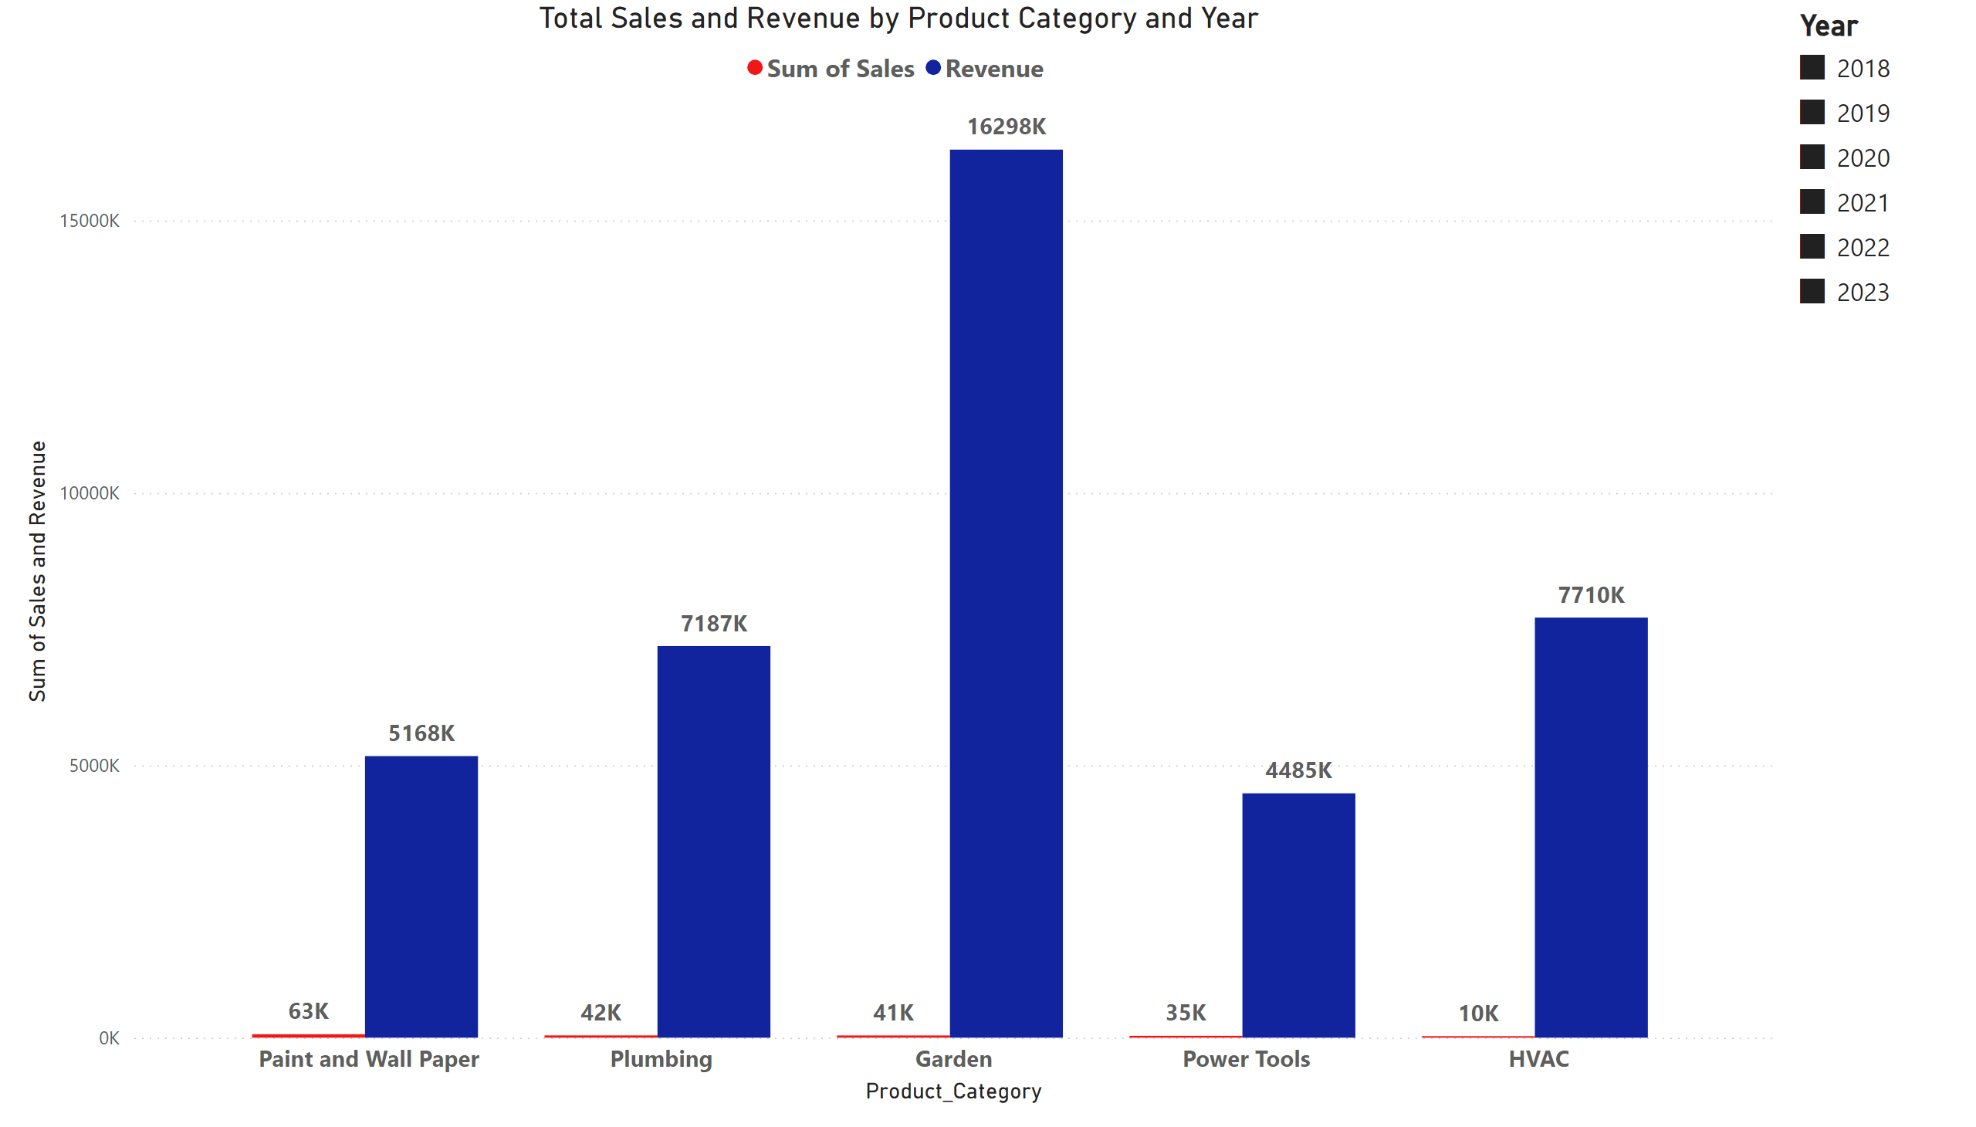
1b - Total Sales and Revenue by Product Category and Year
Notes:
slicer
No alt text provided
Total Sales and Revenue by Product Category and Year
No alt text provided

Slide 4
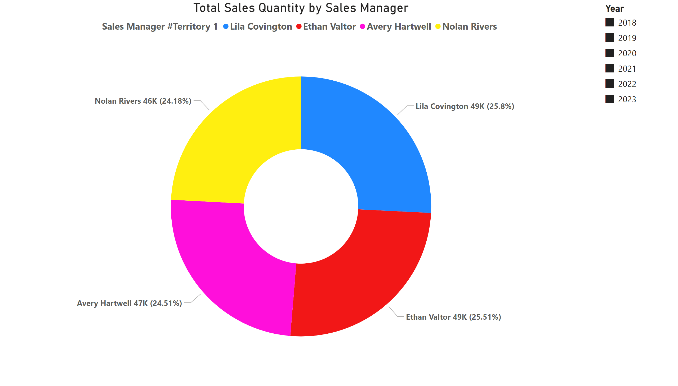
2a - Total Sales Quantity by Sales Manager
Notes:
slicer
No alt text provided
donutChart
No alt text provided

Slide 5
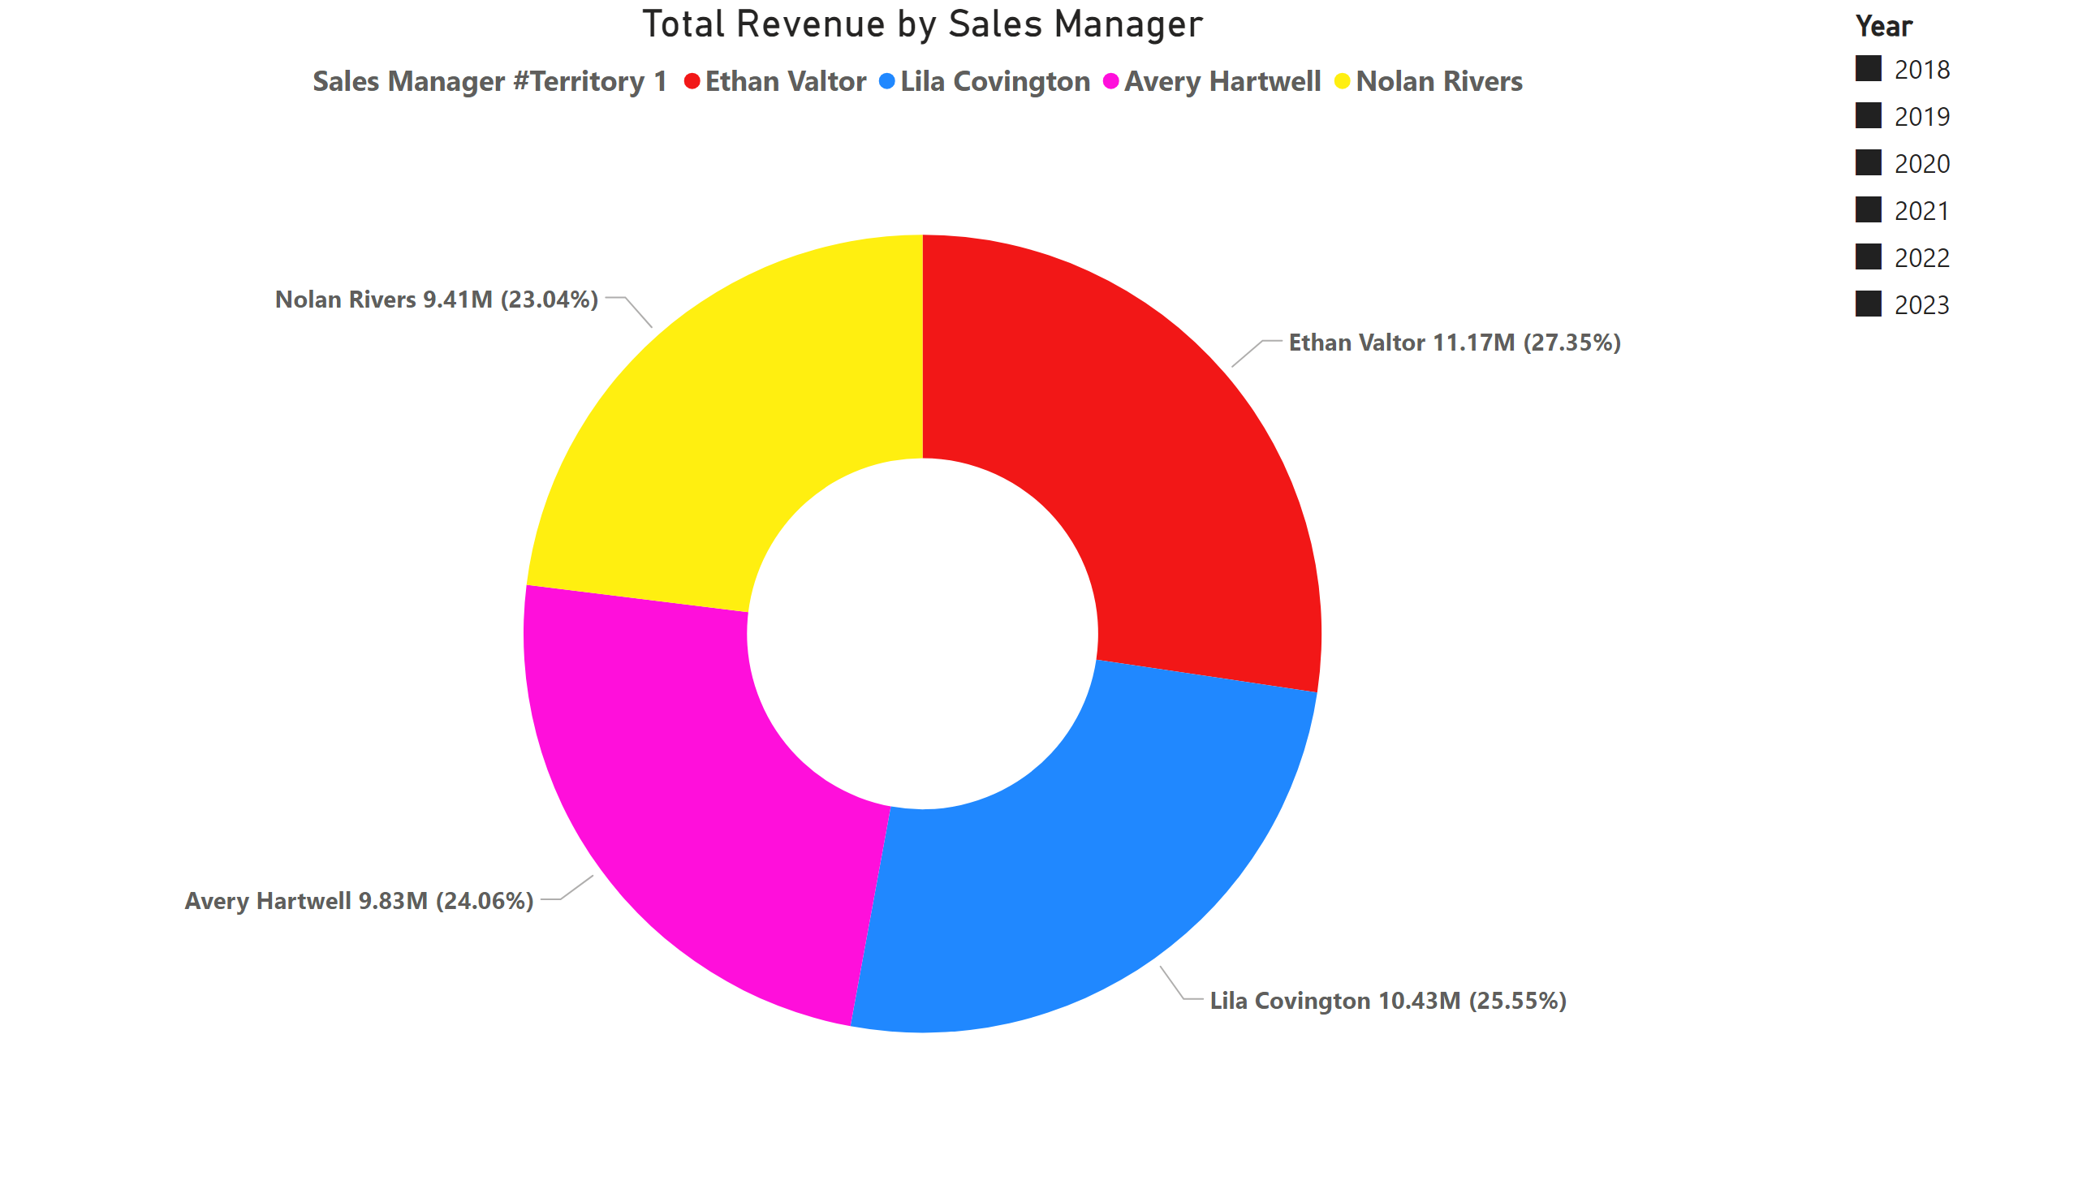
2b - Total Revenue by Sales Manager
Notes:
donutChart
No alt text provided
slicer
No alt text provided

Slide 6
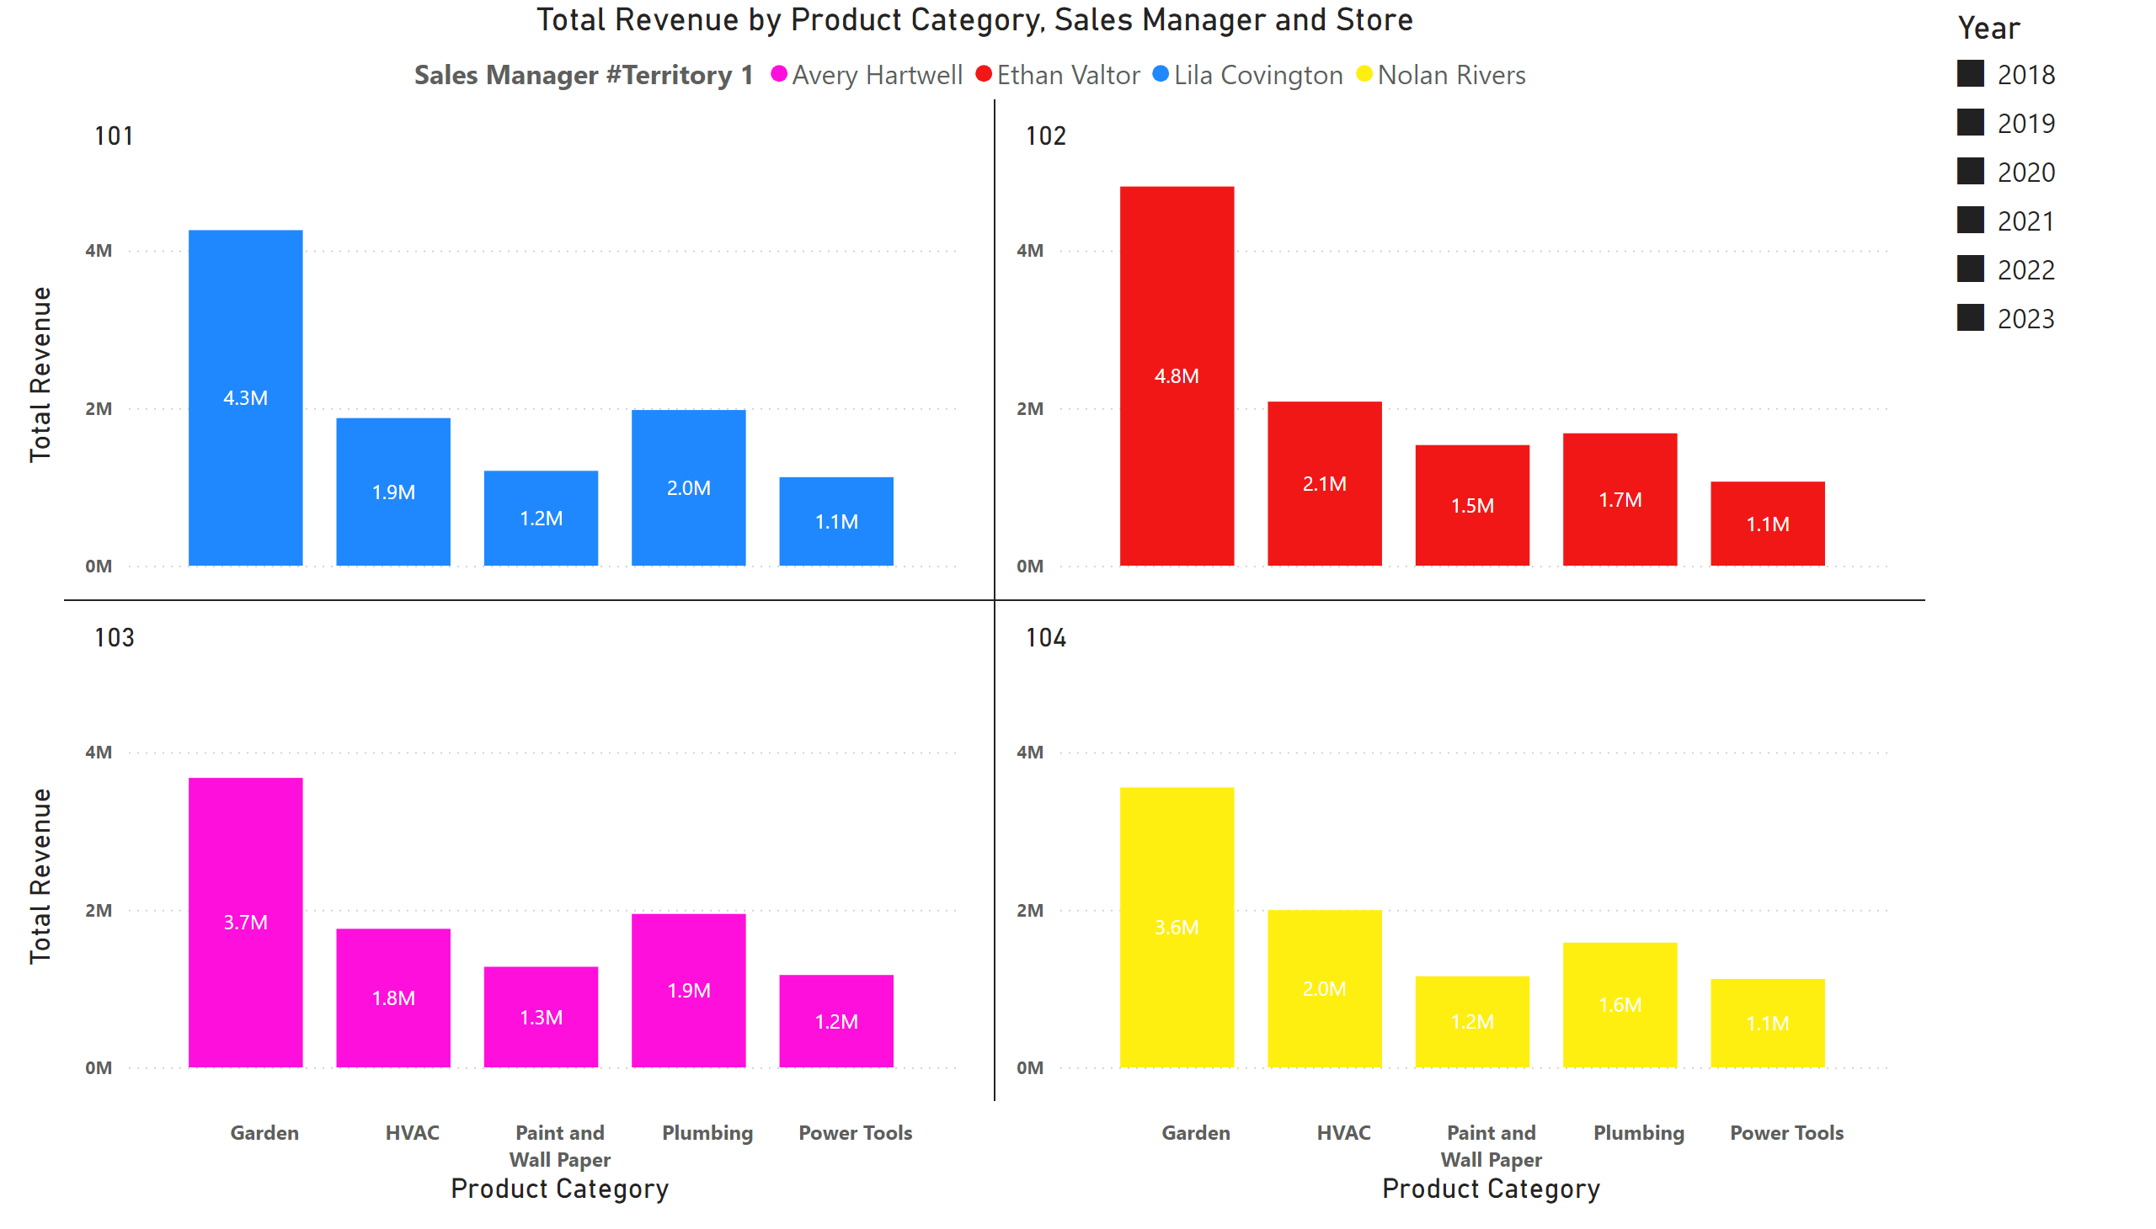
3a - Total Revenue by Product Category, Sales Manager and Store
Notes:
Total Revenue by Product Category, Sales Manager and Store
No alt text provided
slicer
No alt text provided

Slide 7
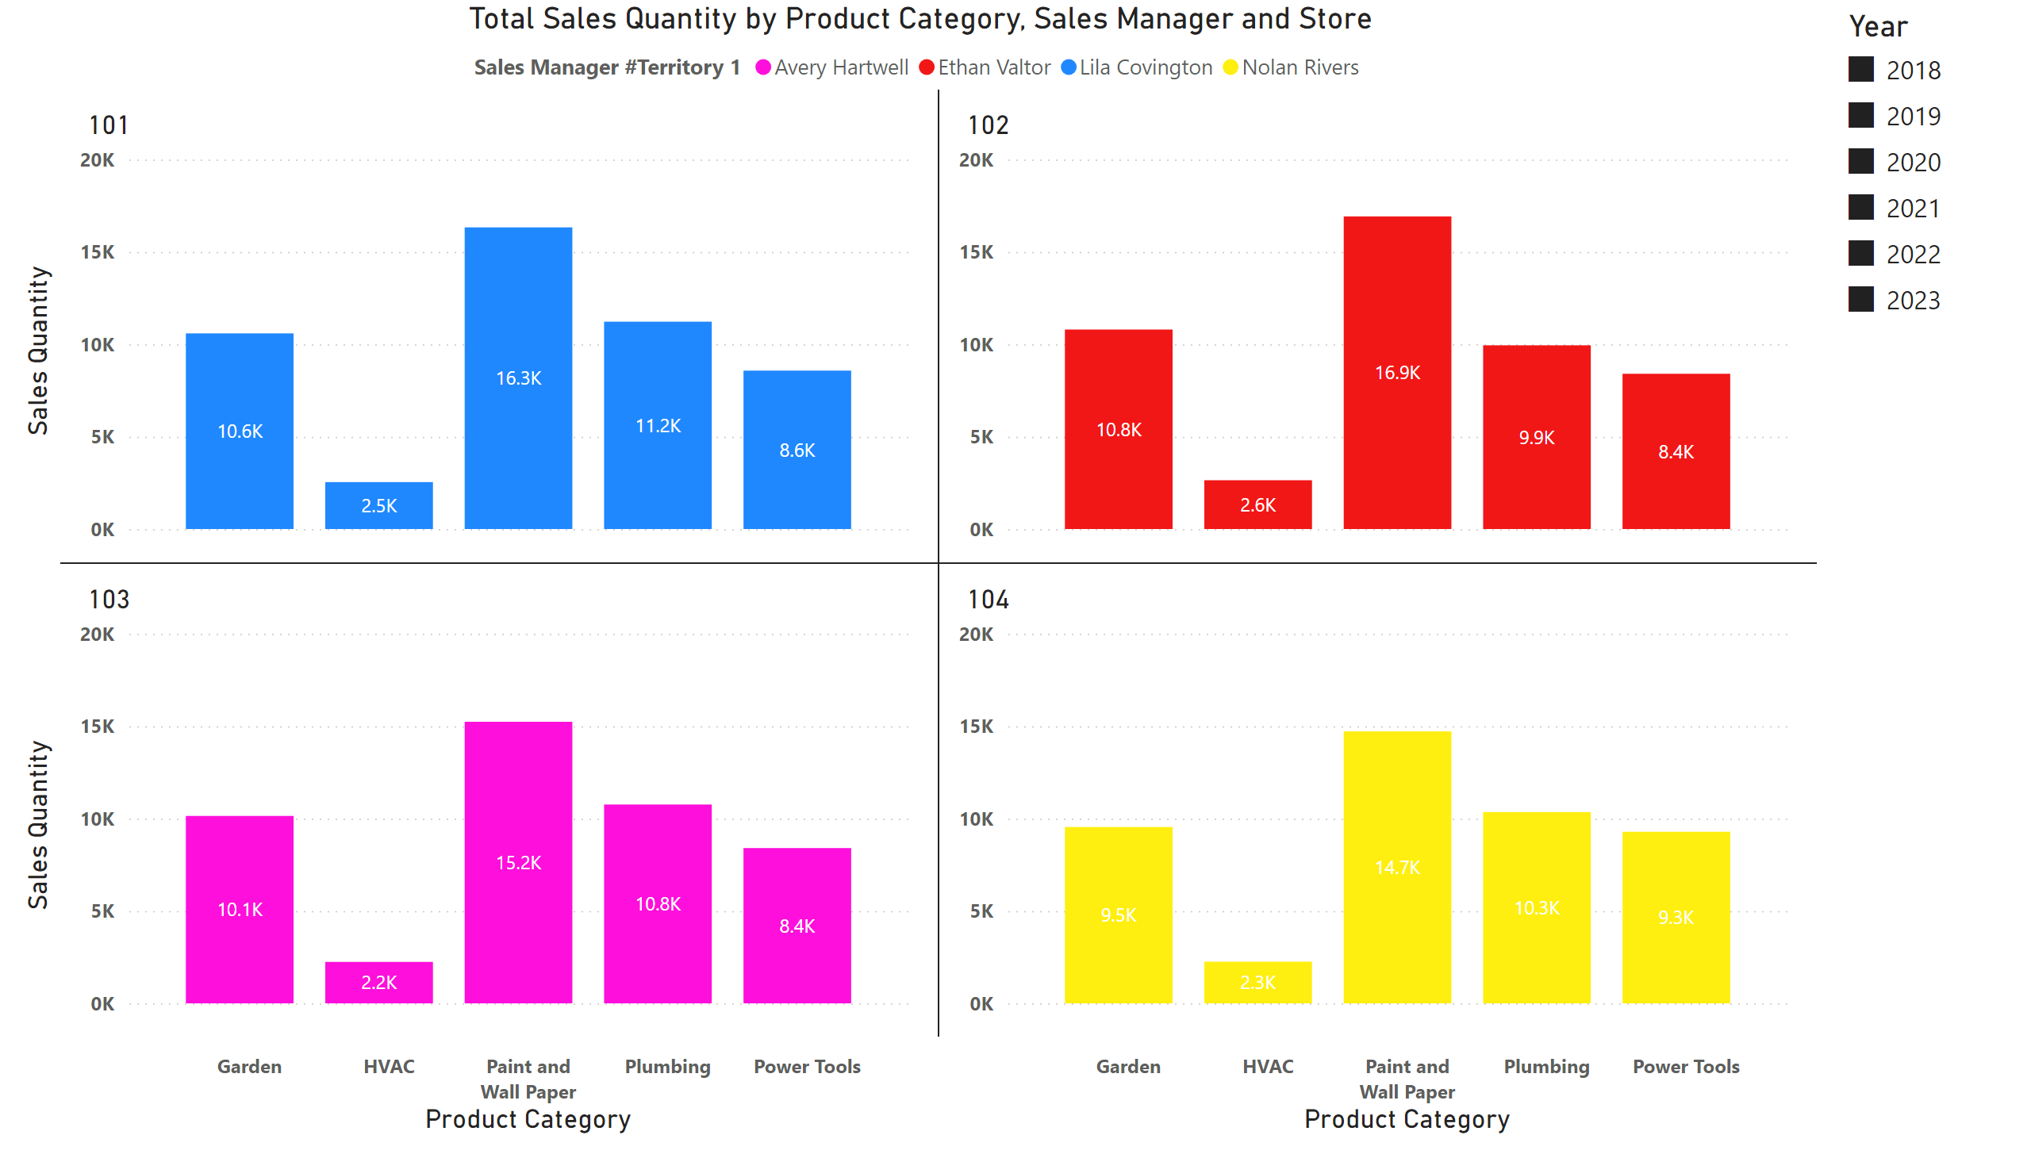
3b - Total Sales Quantity by Product Category, Sales Manger and Store
Notes:
slicer
No alt text provided
Total Sales Quantity by Product Category, Sales Manager and Store
No alt text provided

Slide 8
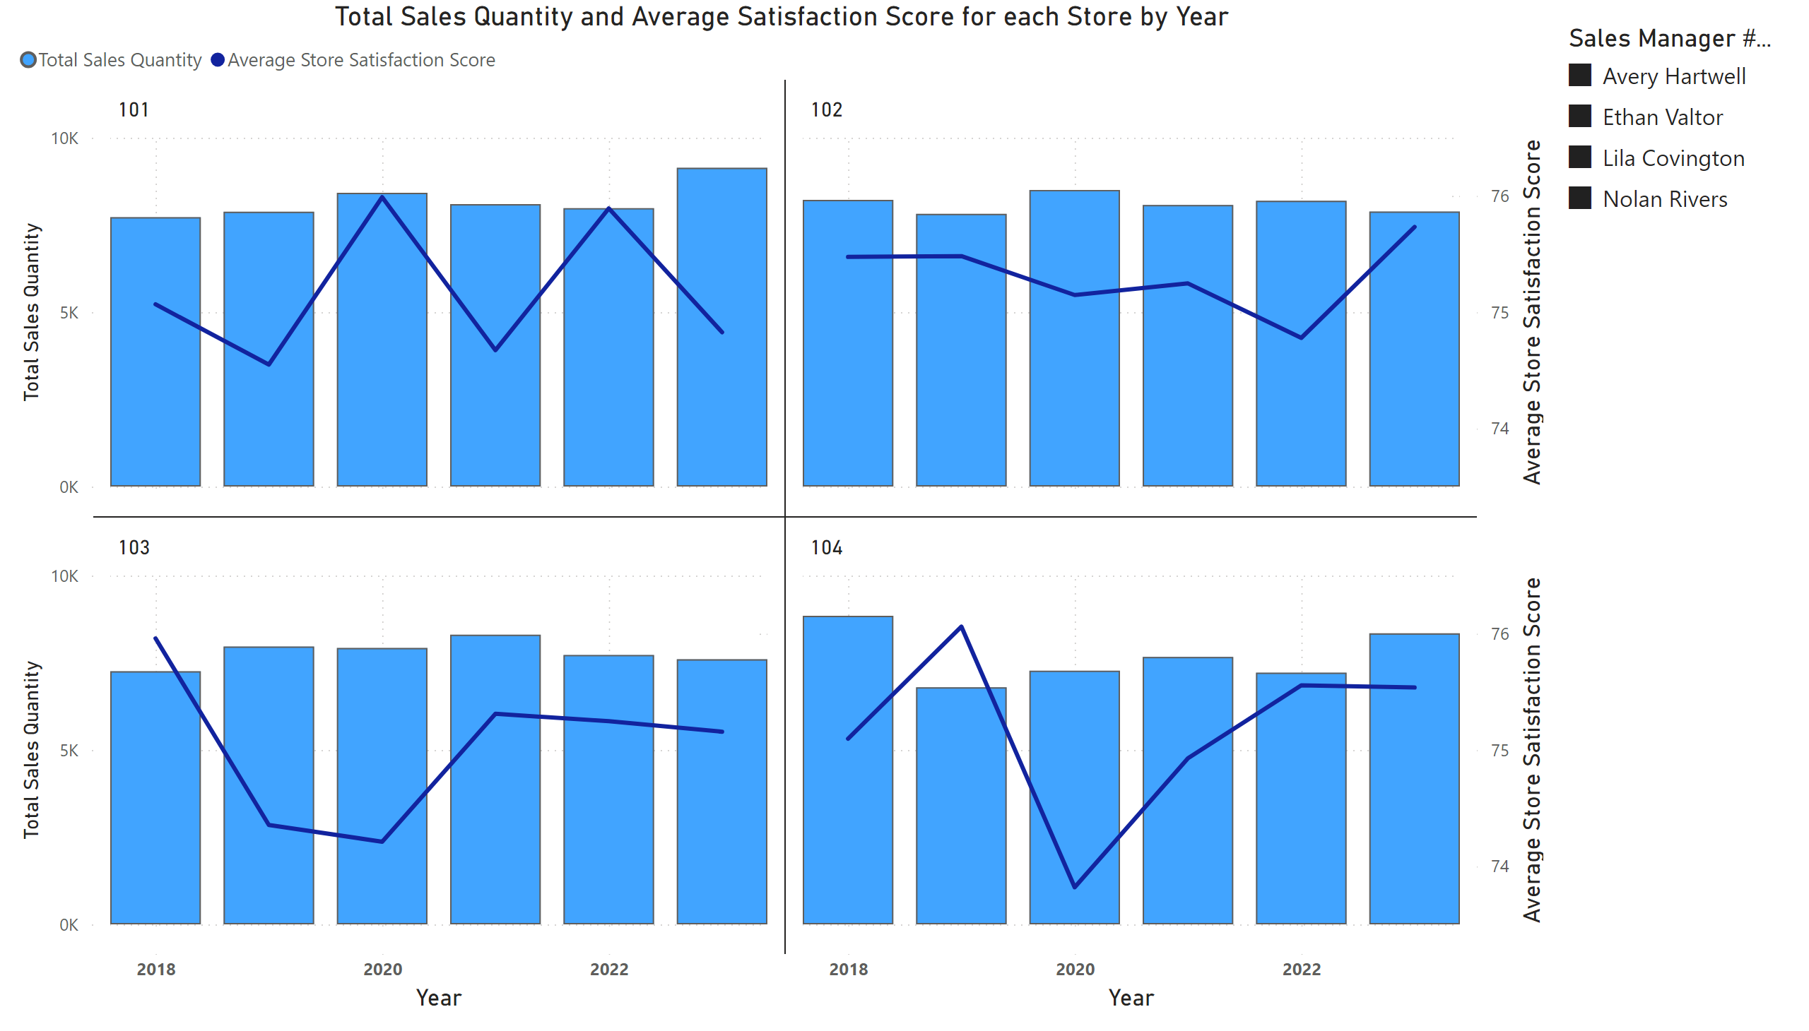
4a - Sales Quantity and Satisfaction Score for each store
Notes:
slicer
No alt text provided
Total Sales Quantity and Average Satisfaction Score for each Store by Year
No alt text provided

